Slide 1

Term Project – Twitter
Group 4
202035508 KimSongeon
202135733 KimSeoyuong
202235002 KangGwion
202235040 ParkGunwoo
202235122 JungEunseop

Slide 2
01
Contents
DB Schema
design
Normalization
Process
Final DB Schema
Demo

Slide 3
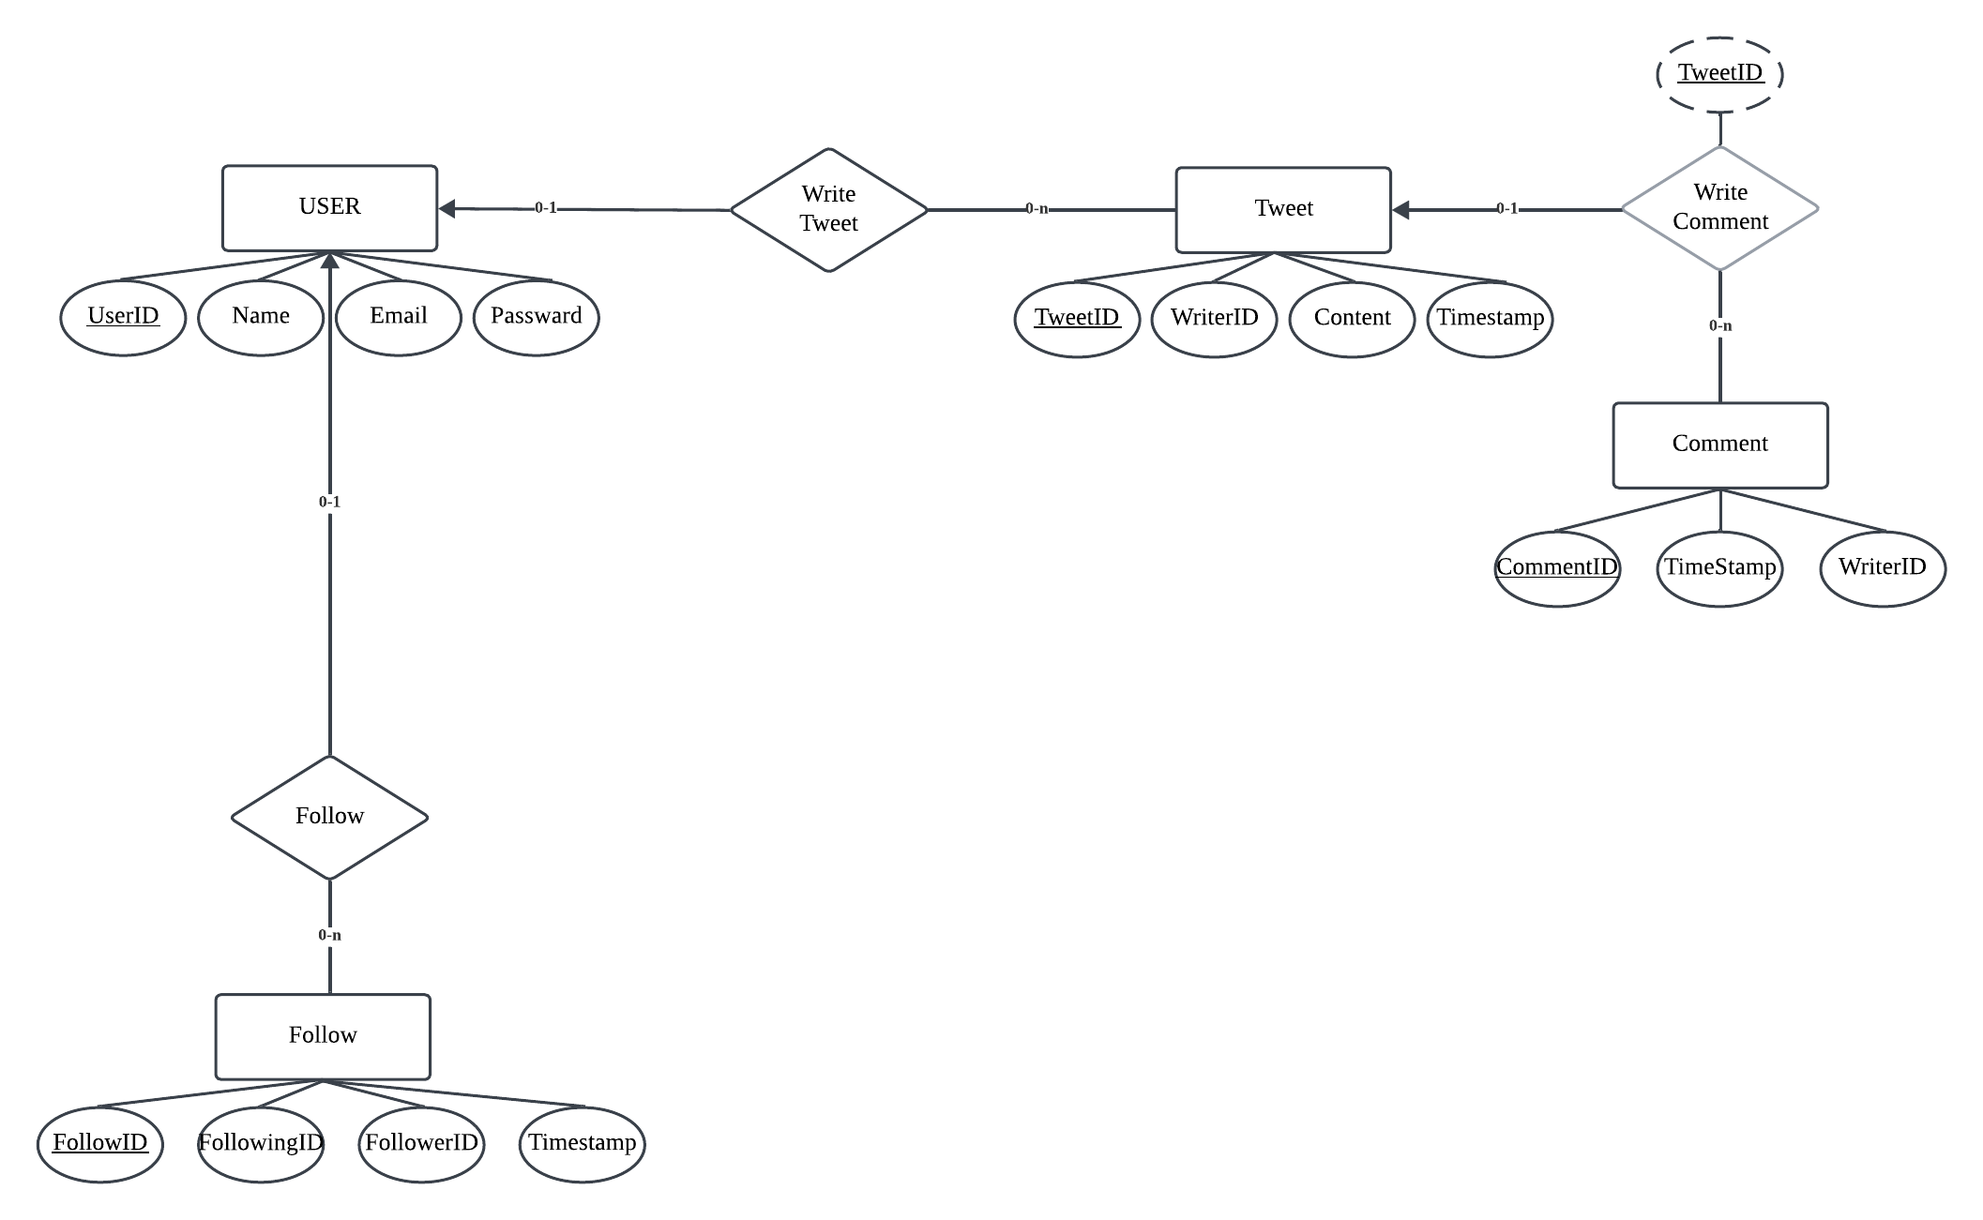
02
DB Schema design

Slide 4

03
Normalization Process Init
< Process >
basics | 1NF | 2NF | 3NF | BCNF
1NF
Comment : CommentID(PK) update
Possible duplicate data and comments without TweetID
Notes:
중간발표에 낸 정규화 과정을 오롯이 담은 보고서를 보시면 더 자세한 과정을 볼 수 있습니다

Slide 5
03
Normalization Process
< Process >
basics | 1NF | 2NF | 3NF | BCNF
User : UserID (PK)
Follow : Follower / Following
Comment : TweetID / UserID (FK) referencing Tweet(TweetID) and User(UserID)
BCNF
Notes:
중간발표에 낸 정규화 과정을 오롯이 담은 보고서를 보시면 더 자세한 과정을 볼 수 있습니다

Slide 6
03
Final Normalization Process
UserID, Name, Email, Password
PK – UserID
User
UserID, FollowingID, Timestamp
PK/FK – UserID, FollowingID
Follower
UserID, FolloweID, Timestamp
PK/FK – UserID, FollowerID
Following

Slide 7
03
Final Normalization Process
CommentID, TweetID, WriterID, Content, Timestamp
PK – CommentID FK – TweetID, WriterID
Comment
TweetID, WriterID, Content, Timestamp
PK – TweetID FK – WriterID
Tweet

Slide 8
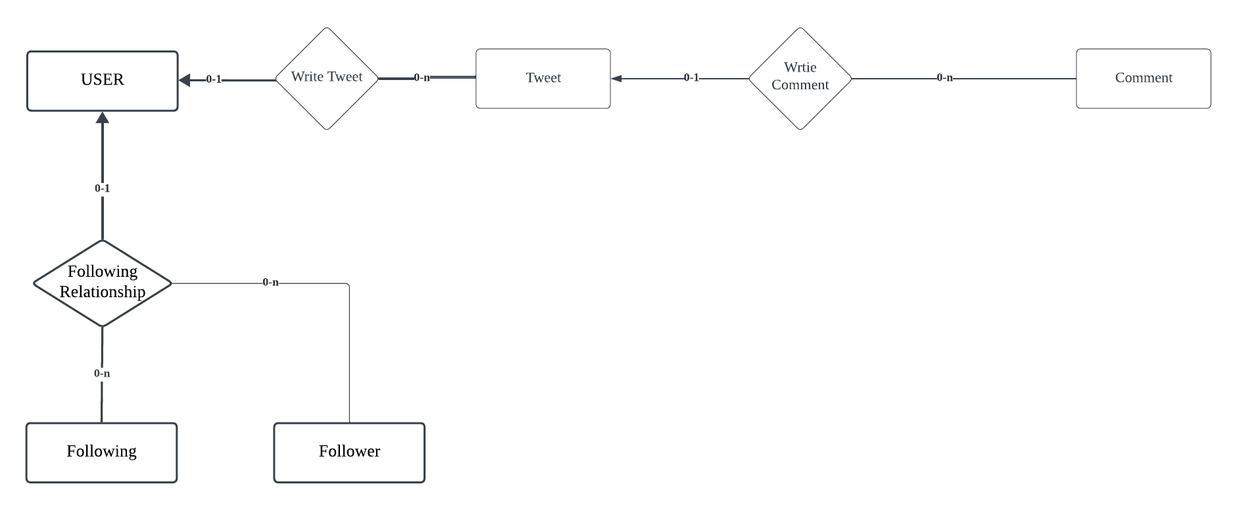
04
Final DB Schema

Slide 9
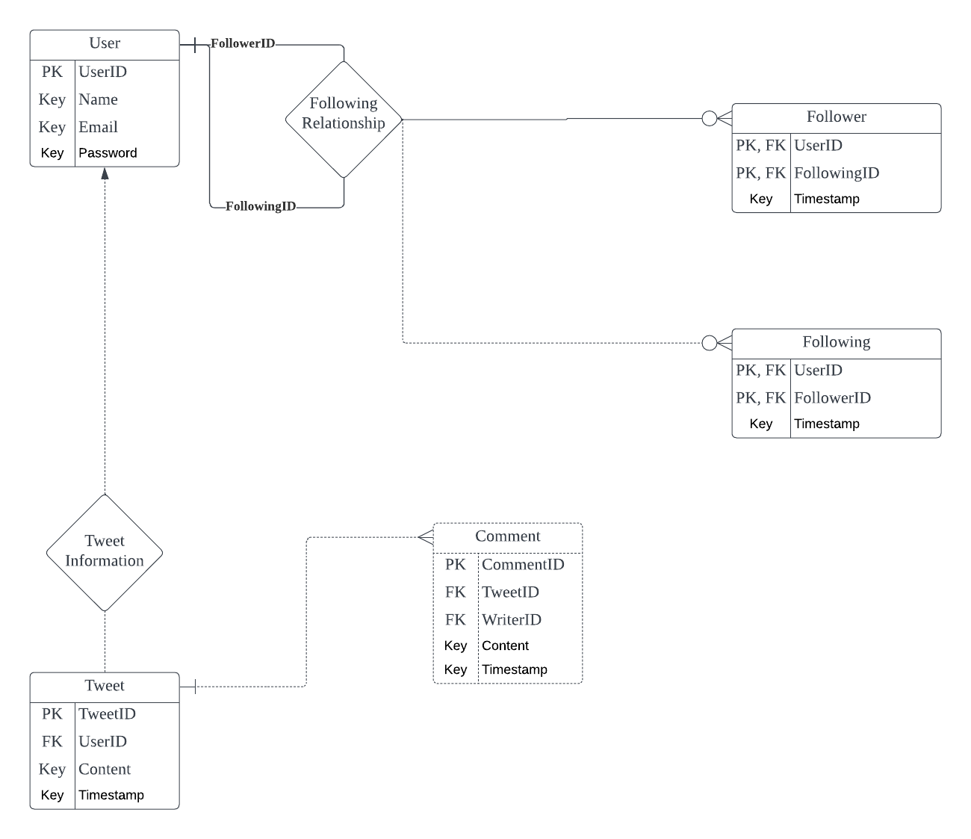
04
Final DB Schema

Slide 10
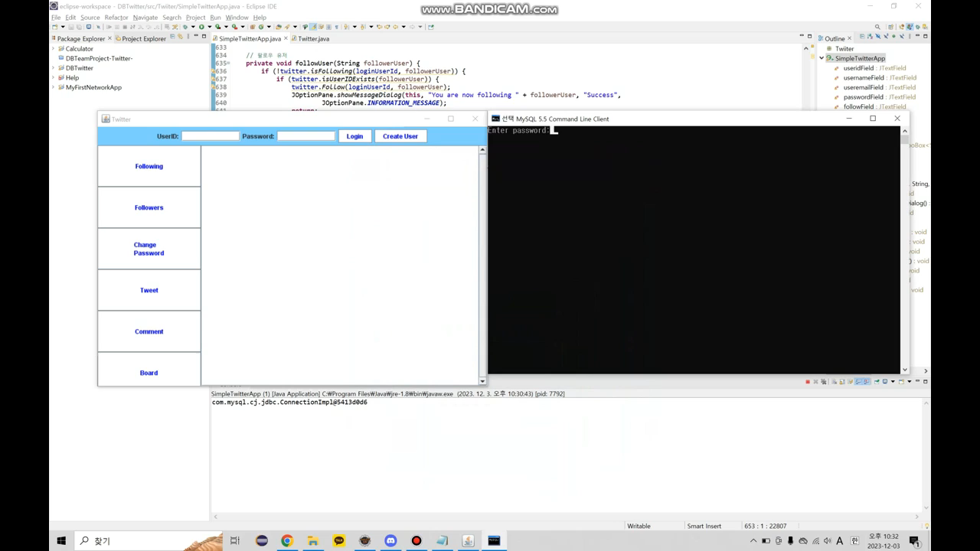
05
Demo

Slide 11
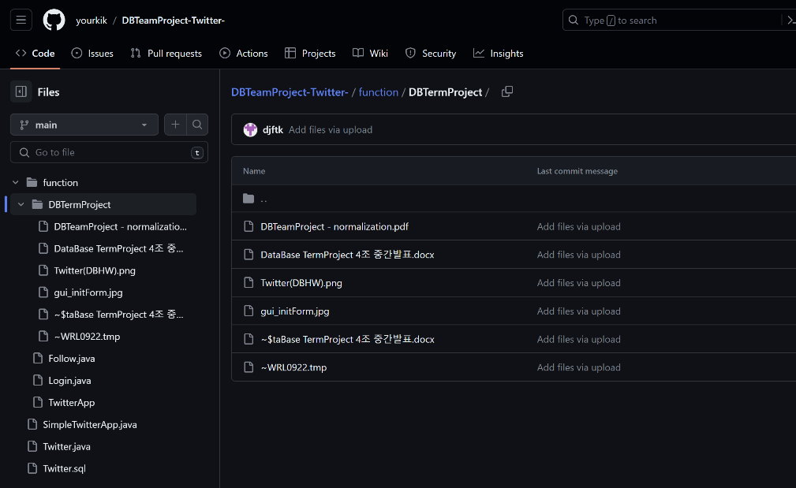
05
Demo of GitHub Link
https://github.com/yourkik/DBTeamProject-Twitter-

Slide 12
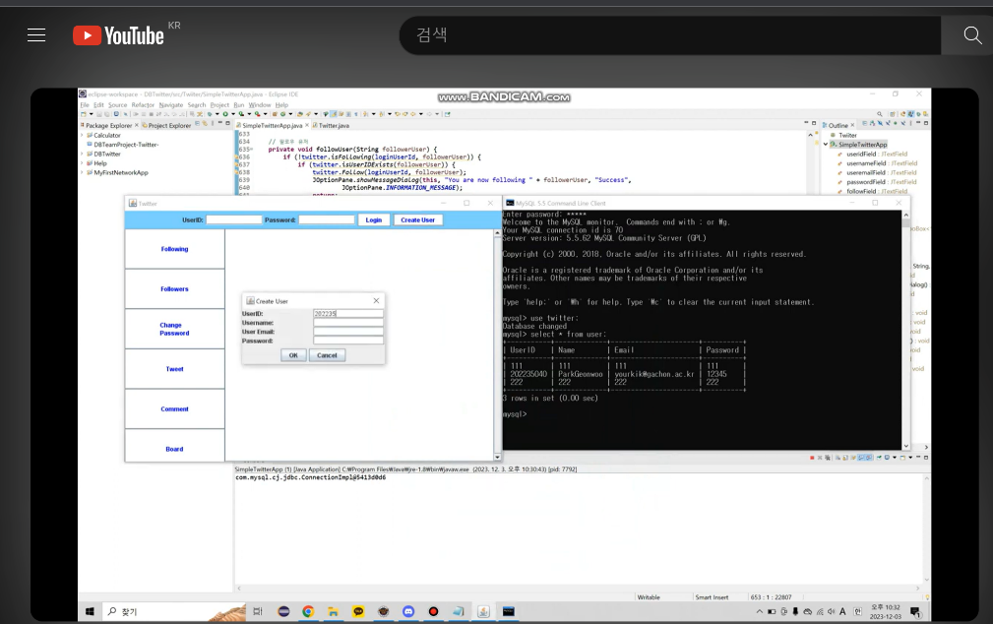
06
Demo Video URL
https://youtu.be/pC-DybxK-Qo

Slide 13
Thank You
From Team4

